Slide 1







Managing Asbestos in your Educational Establishment
How to meet legal requirements and protect students, staff & visitors

Slide 2
Explaining the Risk
Asbestos is a naturally occurring mineral widely used in buildings until 1999.
This means that the majority of education buildings (around 83% according to DfE) contain asbestos.
HSE and DfE position is that generally asbestos should be managed in situ, rather than removed (not the view of the Joint Union Asbestos Committee) and that asbestos exposure should be prevented as far as is reasonably practicable.
So effective management is critical and poor management will endanger lives.
If materials containing asbestos are disturbed fibres can be released.
This puts those who breathe in fibres at risk of developing mesothelioma – a fatal cancer.

Slide 3
In 2017, 27 teaching professionals died of mesothelioma and 7 support staff.
Children are at greater risk. The Government’s Committee on Carcinogenicity calculated that a child exposed to asbestos at age 5, is 5 times more likely to develop mesothelioma that an adult exposed at age 30.

Slide 4
Who is responsible for protecting students, staff and visitors?
The employer has overall responsibility under the Health & Safety at Work Act 1974.
Employers must ensure that staff with delegated responsibilities for day-to-day health and safety are competent and suitability trained.
Under Regulation 4 of the Control of Asbestos at Work Regulations 2012 legal responsibility for safe management lies with the ‘duty holder’.

Slide 5
Who is the duty holder in educational establishments?
‘Duty holders’ includes anyone with an obligation for the maintenance and repair of the premises.
The employer is the main duty holder but school and college leaders share a key role to play in the safe management of asbestos (in the same way that they report to the employer on other statutory responsibilities).
Where governing bodies are not the employer, they nonetheless have duties as ‘persons in control of premises’ under Health and Safety at Work Act and should offer strategic direction and oversight of asbestos management to mitigate against the risk to employees and others.

Slide 6
School/College leaders should
Clarify with their employer (whether LA, Trust, GB or other) what is expected of them.
Discuss with the employer the information, instruction, resources (including time) and training that is necessary in order to fulfil this role effectively.
Notes:
.

Slide 7
What needs to be done to meet core requirements
There are 4 core steps:
Step 1 – undertake a survey
A survey must be undertaken by an asbestos professional to indicate the location, type and conditions of all asbestos containing materials (ACMs.)
surveys should be undertaken in accordance with HSE guidance by a UKAS accredited surveyor https://www.hse.gov.uk/asbestos/surveyors.htm
the UKAS website https://www.ukas.com/ will help you find an accredited surveyor
surveyors must be told to indicate areas of ‘presumed’ hidden asbestos. Certain types of schools built using prefabricated components (known as system built) contain large amounts of hidden asbestos
if the survey uncovers evidence of high-risk materials, the surveyor will recommend removal
Notes:
.

Slide 8
Step 2 – assess the risk
‘material’ assessment – provided within the survey – assessment of each item of material.
‘priority’ assessment - an assessment of the likelihood of disturbance, with input from the educational establishment, as they will best understand how the building is utilised and the potential risks, supported by the surveyor (See HSG227 https://www.hse.gov.uk/pubns/priced/hsg227.pdf – without consulting this, the risk is likely to be underestimated).
‘total’ assessment – the combined assessment from the two assessments, which will dictate how the asbestos is managed.*
see further guidance from the HSE at https://www.hse.gov.uk/pubns/books/hsg227.htm Appendix 4 has model guidance for schools that points out that normal classroom activity is highly likely to disturb accessible asbestos.
Notes:
.

Slide 9
Step 3 – create a register
Together the survey and risk assessment will lead to an asbestos register which will:
provide a clear record, including photos, showing the location, extent and condition of ACMs.
capture where asbestos may be present or must be assumed to be present if it can not be ruled out.
The register is a working document which must be kept under review in light of changing circumstances and shared with staff and union health and safety reps.
Notes:
.

Slide 10
Step 4 – Prepare an Asbestos Management Plan (AMP)
Required by law. Its development should flow from the information in the register.
Will set out day-to-day arrangements for controlling the risks from all ACMs (hidden and accessible).
Should be shared with staff and subject to consultation with union safety reps. This is a legal requirement under Safety Representatives & Safety Committees Regulations 1977 https://www.tuc.org.uk/sites/default/files/BrownBook2015.pdf
Notes:
.

Slide 11
What does the AMP need to include?
Leadership commitment and ownership of risk.
A clear outline of roles and responsibilities for safe management.
A plan for communication with staff, visitors and contractors.
Arrangements to monitor the condition of identified accessible or presumed ACMs and presumed ‘hidden’ asbestos, particularly the case in system-built schools.
Procedures for controlling maintenance work and contractors.
Emergency procedures in case of inadvertent disturbance of ACMs
Notes:
.

Slide 12
Particular arrangements for managing asbestos in system-built buildings
Assume that asbestos materials are present throughout, including around structural columns, beneath casings and claddings and within ceiling and wall voids unless clear evidence to the contrary.
Comply with HSE guidance for sealing asbestos within columns and replacing damaged and missing ceiling tiles.
See HSE guidance
http://www.hse.gov.uk/services/education/asbestos-system-buildings.pdf and seek professional advice.
Notes:
.

Slide 13
Part 4 - Communication & Training
Clarify with the main duty holder what is expected and what training you will need to discharge these functions.
Ensure that other staff receive information instruction and training appropriate to their role.
Even staff who have no role in managing the building or carrying out repairs need to know the location of ACMs, the potential risk from ACMs and the procedures for reporting damage.
Don’t forget to include cleaners, temporary and supply staff
Posting the AMP and register on the website may help reassure parents/carers.
Keep staff, parents and carers fully informed of developments.
Notes:
.

Slide 14
Consultation with health and safety reps
Section 2 of the Health and Safety at Work etc Act 1974 requires employers to consult with health and safety reps generally on health and safety matters – a requirement amplified by Regulation 4a of the Safety Representatives and Safety Committees Regulations 1977.
This means that whenever asbestos is identified, disturbed or removed, health and safety reps must be consulted. Health and safety reps have an important role in ensuring duty holders are aware of the potential level of disturbance in each area from everyday activity.
Notes:
.

Slide 15
What to do if something goes wrong…
In such cases, if there has been, or may have been, a disturbance.
Stop any activity immediately.
Remove everyone from the area.
Leave behind equipment and personal possessions.
Prevent access to the area.
Seek urgent advice re: remedial action from the main duty holder.
Contact the HSE to report escape of fibres. https://www.hse.gov.uk/riddor/index.htm
Advise affected staff/pupils/parents to record potential exposure via their GP.
Notes:
.

Slide 16
Part 5 – Keep the register and AMP under review
DfE and HSE recommend annually.
Or more frequently if there is new information, changes in key staff, or if work takes place on ACMs or damage occurs.
Notes:
.

Slide 17
How to safely undertake construction/maintenance work
Consult with trade union health & safety reps
The general survey will not have identified all the ACMs that could be present but are hidden
The surveyor, clearance analyst and laboratory should be independent of the asbestos contractor (https://www.hse.gov.uk/asbestos/managing/licensedkey.htm )
Where work will disturb the fabric of the building, a refurbishment and demolition survey is required. https://www.hse.gov.uk/asbestos/managing/survey-refurb.htm
Pass the survey findings to the contractor and make sure they will be applying risk control measures
Work on asbestos should be carried out by HSE-licensed contractors
Licensable work should be undertaken in a fully segregated area outside of normal school/college hours
Notes:
.

Slide 18
Work which may disturb ACMs – what needs to happen upon completion?
The supervisor of the work will advise on procedures to be undertaken before the area can be confirmed as suitable for re-occupation.
Certificate of Reoccupation should be issued before reoccupation by an accredited, independent organisation.
Asbestos containing waste must be disposed of in accordance with Hazardous Waste Regulations 2005, which is the responsibility of the contractor but the duty holder, or their representative, must obtain a note to confirm proper disposal.
Unsafe removal works may lead to prosecution by HSE, hefty fines, even imprisonment.
Notes:
.

Slide 19
Flooding
Where educational establishments have been flooded, they need to be investigated by asbestos contractors who can advise on what needs to be done and when they would be safe to reoccupy.
The water may cause asbestos cement and insulation board to deteriorate and become friable.
Notes:
.

Slide 20
Use of drawing pins and staples
Inserting drawing pins or staples into asbestos insulating board (AIB), ceilings or walls - when mounting displays or putting up decorations in classrooms - is an activity which must not take place, due to the potential for asbestos fibre release.
Education staff should not mount displays until either the AIB is either removed or sealed, as a temporary solution; or it is categorically confirmed that no asbestos is present.
Notes:
.

Slide 21
Asbestos removal
Asbestos removal should be undertaken only when the building is not occupied i.e., during holidays, weekends or evenings. Only in exceptional circumstances should removal proceed when the building is occupied.
In such circumstances the areas where removal is taking place must be either physically separate from the occupied parts of the premises or be capable of being sealed off in some other way.
Notes:
.

Slide 22
Asbestos removal (2)
Removal should be undertaken only by contractors who are local authority approved and expert in asbestos stripping procedures and are licensed under the Asbestos (Licensing) Regulations.
The contractors are required by these Regulations to provide adequate information to persons who may be in the vicinity of the work or who may be affected by the work, while the Control of Asbestos Regulations impose an obligation on employers to provide adequate information and protection to employees affected by the removal of asbestos.
Notes:
.

Slide 23
Asbestos contractors
An up-to-date list of licensed contractors including the type of licence held is available on the HSE website at: https://webcommunities.hse.gov.uk/connect.ti/asbestos.licensing/view?objectId=8516
Notes:
.

Slide 24
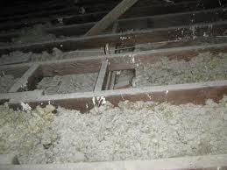
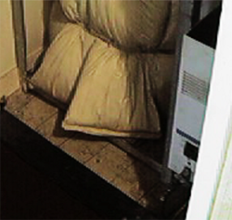
Part 6 – Where is Asbestos found
Loose Insulation
  Wall, ceiling and floor cavity insulation
  Cylinder jackets
  Jiffy bag insulation
  Quilts for pipe and boiler jackets

Slide 25
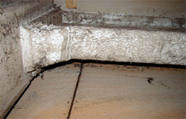
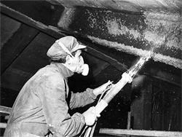
Asbestos in Buildings
Sprayed Coatings
  Sprayed onto ceilings and steel/concrete beams for fire protection
  Stopped using asbestos in 1974
  Up to 85% asbestos

Slide 26
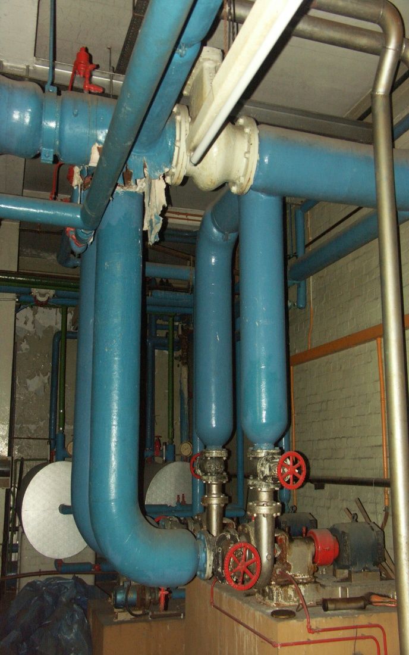
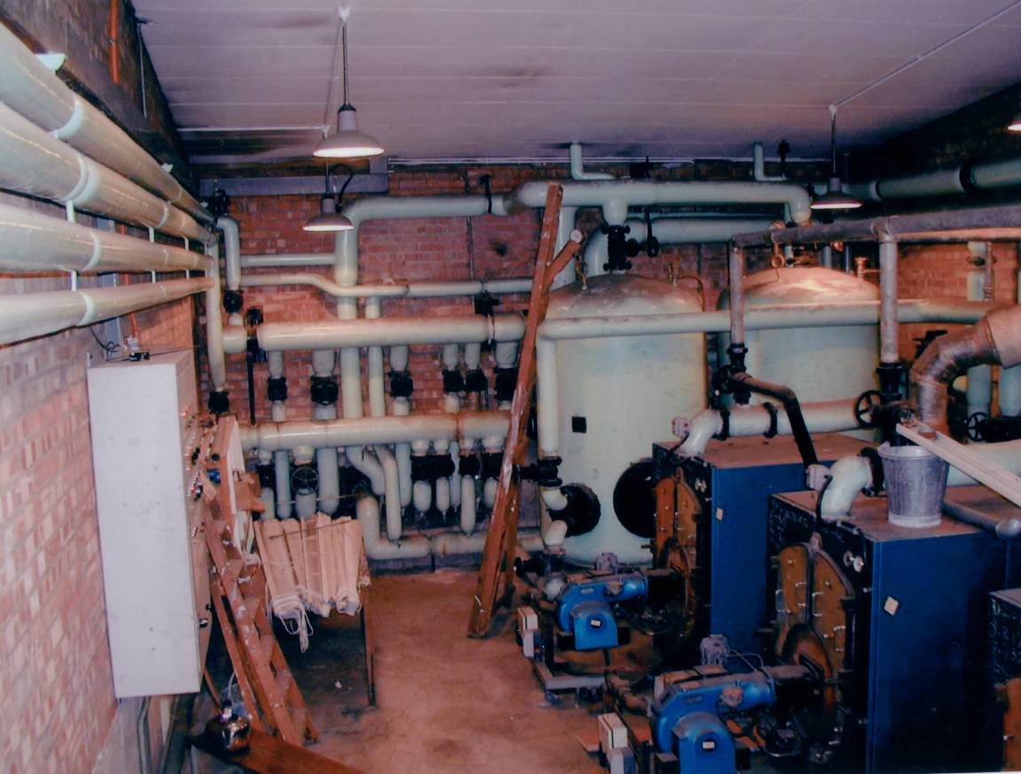
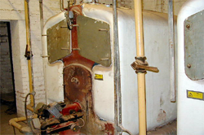
Asbestos in Buildings
Thermal Insulation
  Lagging on boilers and pipes
  Pre-formed sections used on large pipes, vessels and steam trains
  All types of asbestos used
  Up to 85% asbestos content
  Pretty common in 1950s and 60s properties

Slide 27
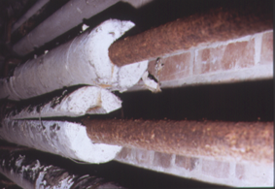
Asbestos pre-formed sections.
Visually similar to modern calcium silicate.

Slide 28
Metal covered asbestos clad column with unsealed vertical gap at front of column. Asbestos can pass through gap into room
Gap where
casing joins
Column gap

Slide 29
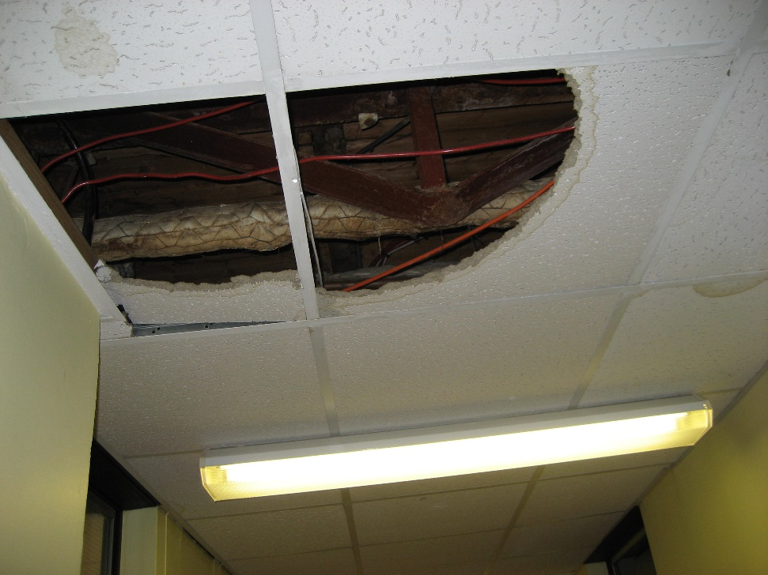
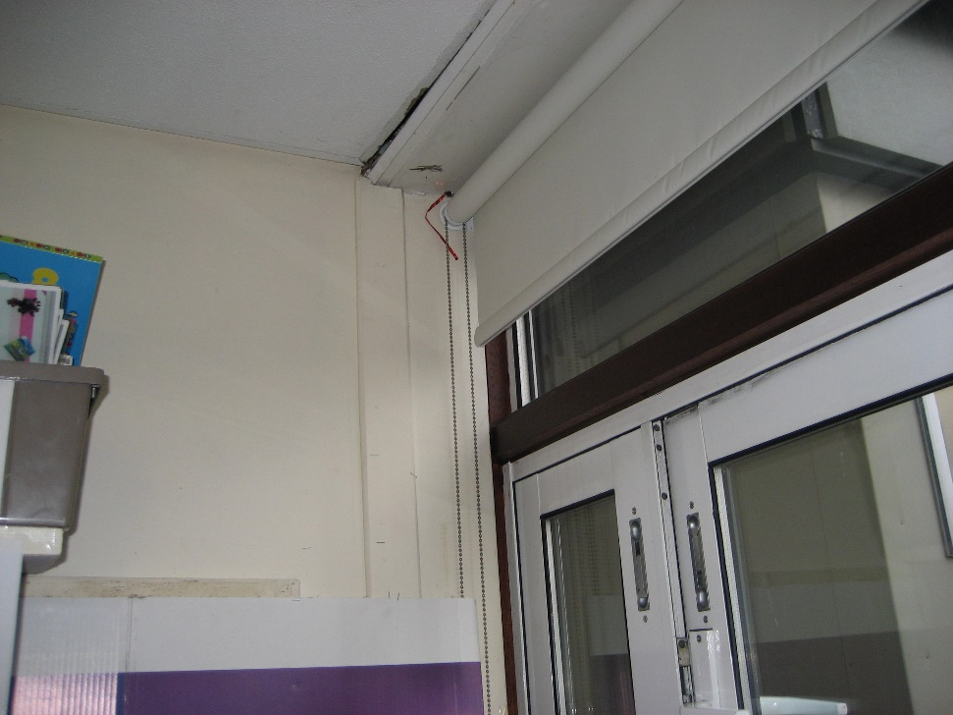
Missing/damaged ceiling tiles let asbestos pass into classrooms via gaps

Slide 30
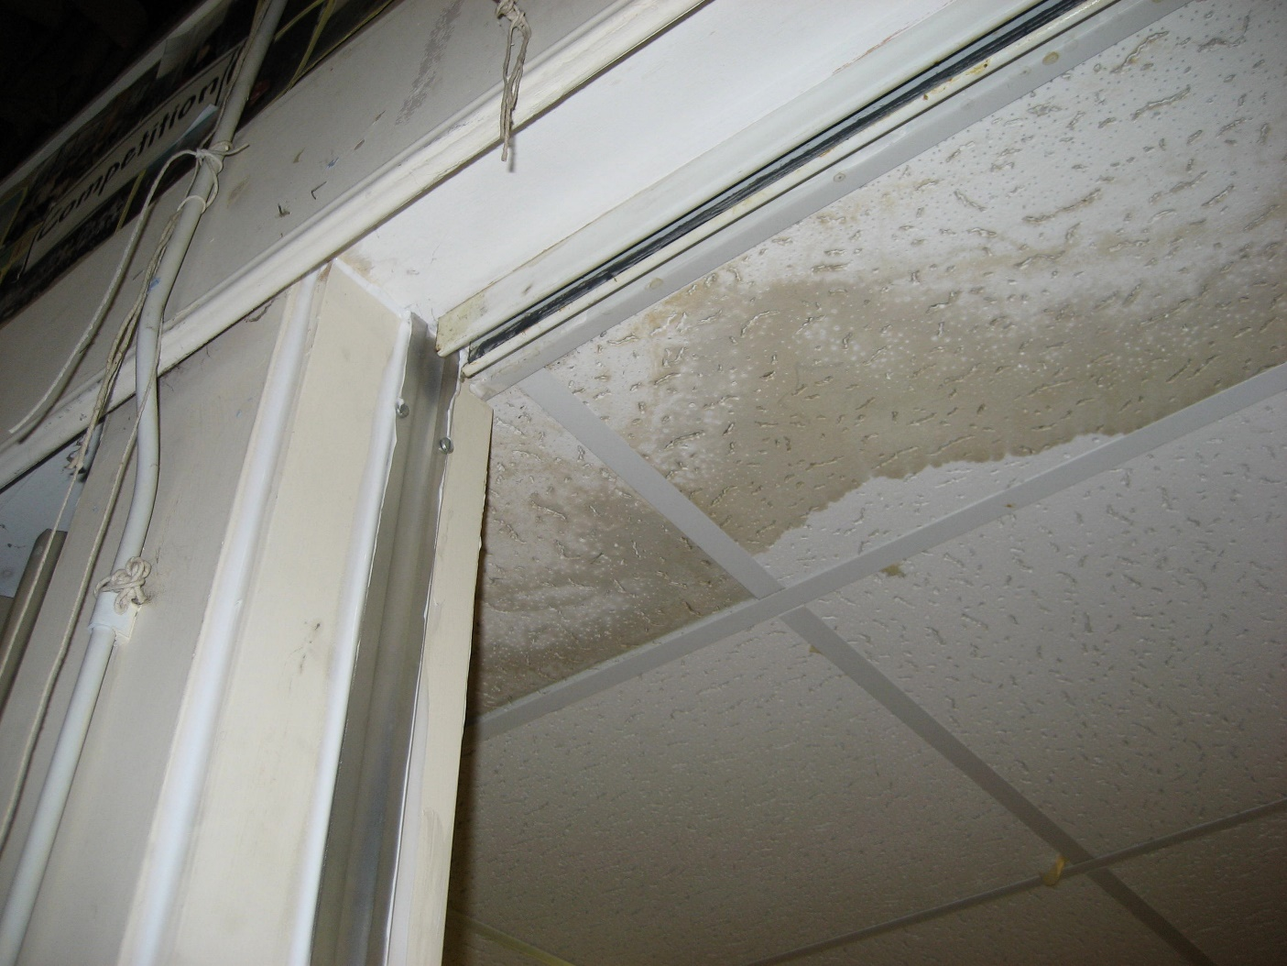
Check ceiling tiles for water damage & column fittings for gaps which let asbestos into room
Water damage
Sealed gap between fitting and column

Slide 31
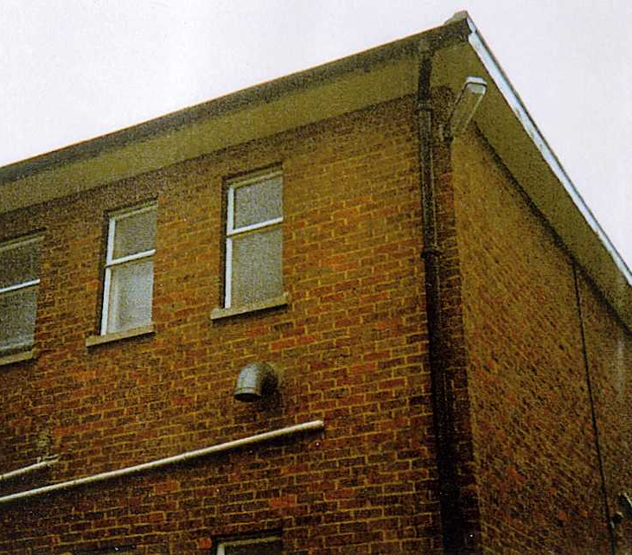
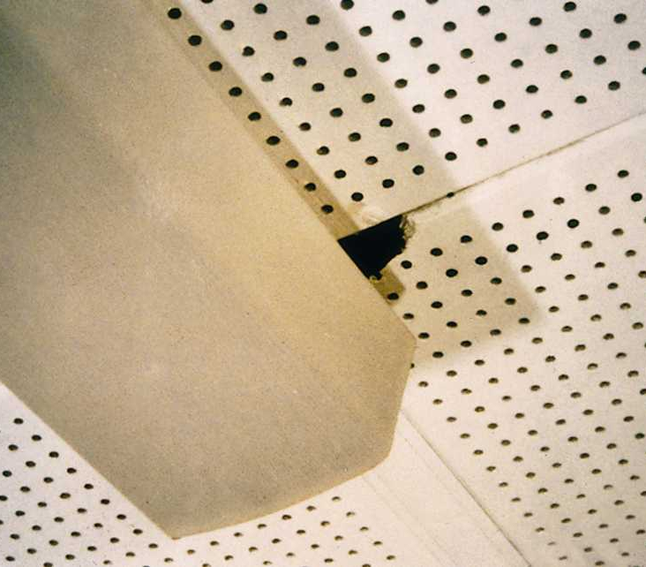
Asbestos Insulating Board

Slide 32
Asbestos Insulation Board (AIB)
Older boards can contain Crocidolite
Usually Amosite or mixture Amosite and Chrysotile in calcium silicate
15 -25% asbestos content
Asbestolux up to 40% asbestos content
Last date of manufacture – circa 1980

Slide 33
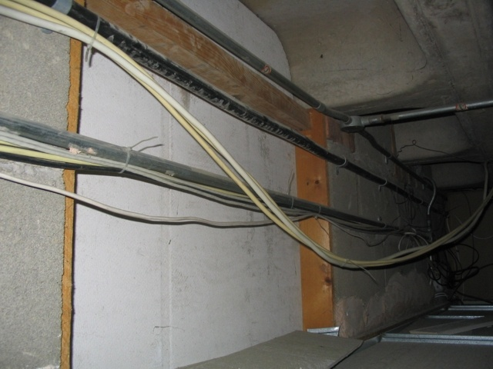
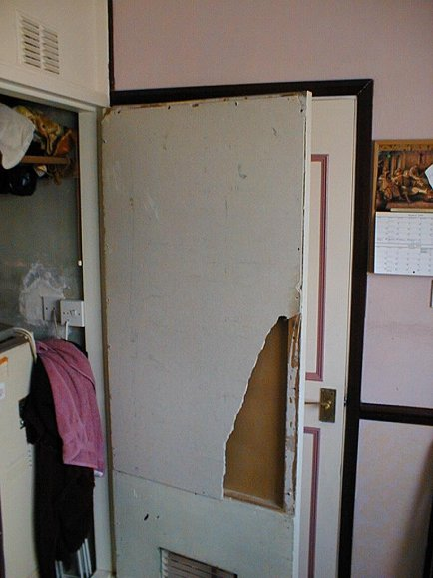
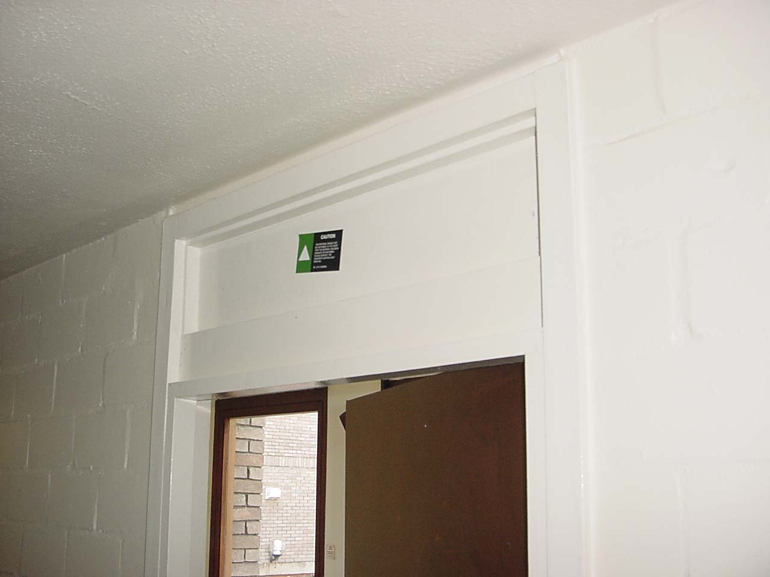
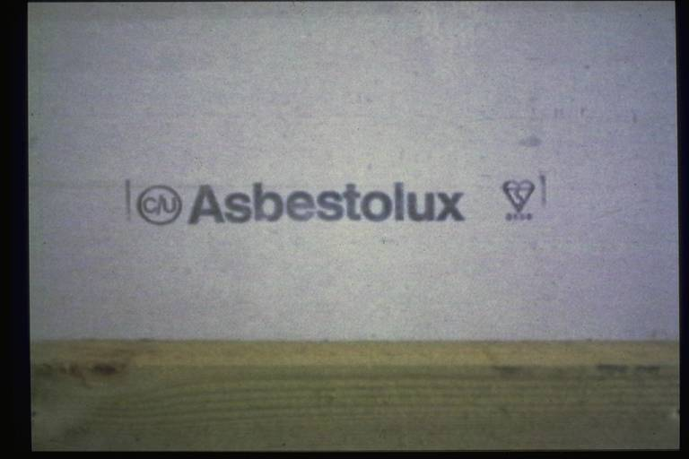
Examples of AIB
Copyright 2008
33
33

Slide 34
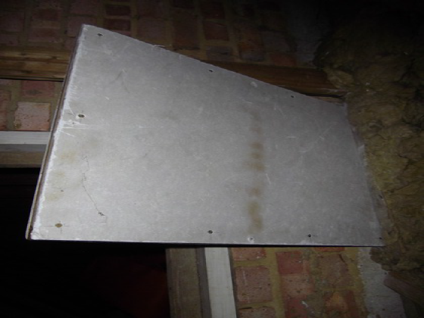
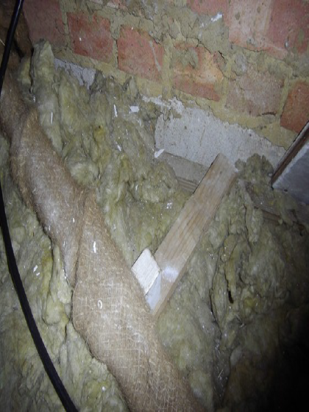
Asbestos in Buildings
Insulating Boards
  Ceiling tiles
  Wall panels
  Firebreaks
  Window panels
  Soffits
  Riser covers
  Heater lining
  Heater cabinets

Slide 35

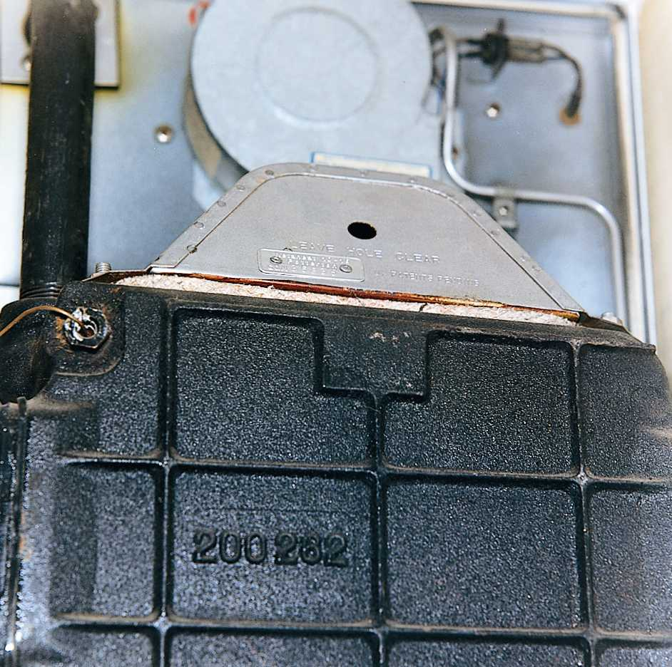
Asbestos textiles

Slide 36
Asbestos Textiles
Crocidolite and Chrysotile widely used
Chrysotile alone from 1970 onwards
Asbestos content usually 100%
Fibre release low unless damaged

Slide 37
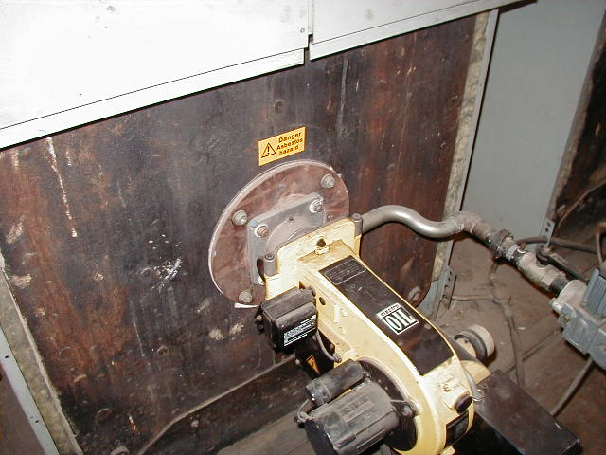
Asbestos Gaskets , Millboard, Paper, Rope seals

Slide 38
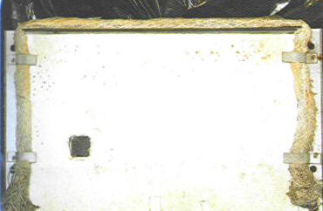
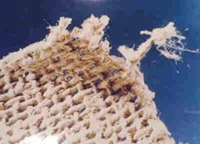
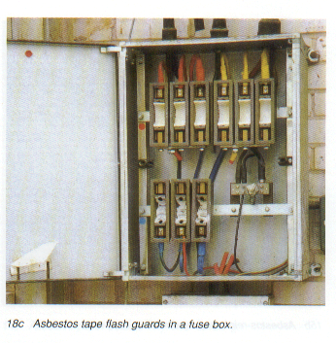
Asbestos textile products

Slide 39
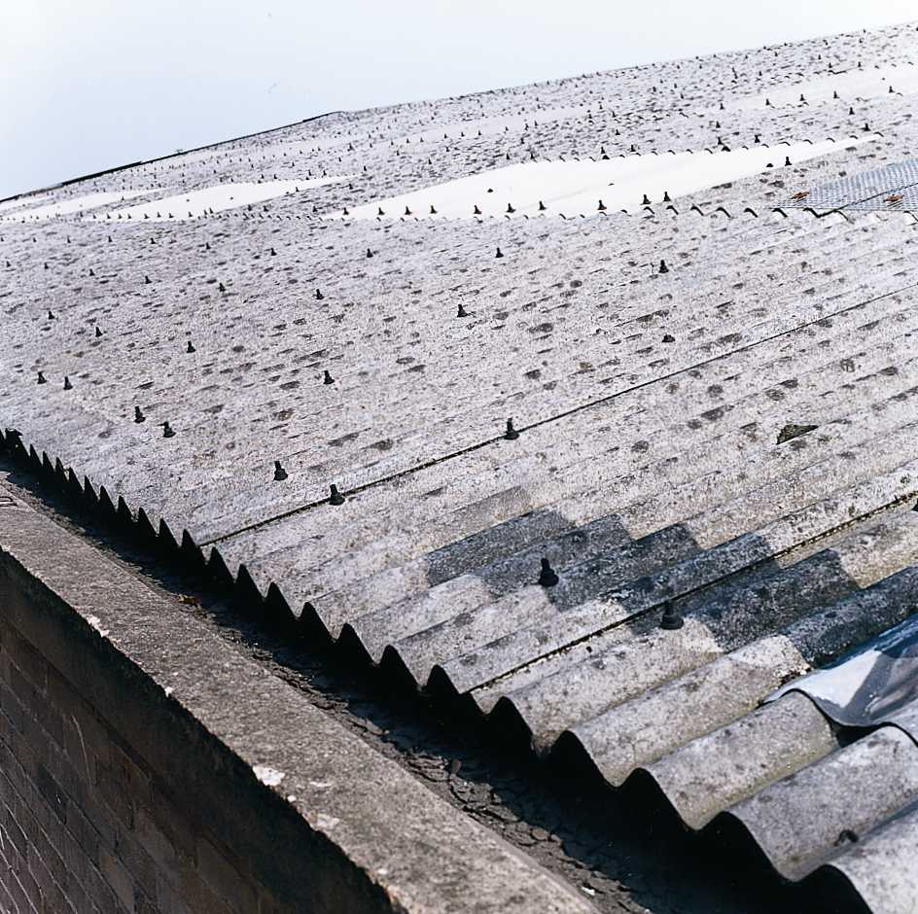
Asbestos cement

Slide 40
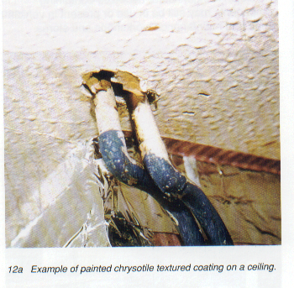
Asbestos in Buildings
Textured Coating
  Wall & ceiling Artex
  Decorative finishes
  Reinforced paint
  Up to 5% Chrysotile
  Sporadic due to application and mixing method

Slide 41
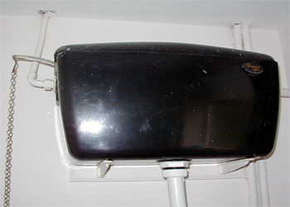
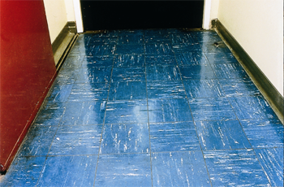

Reinforced Composites
  Toilet cisterns, seats, banister rails, stair nosings & window sills
  Brakes & clutches
  Car batteries
  Thermoplastic flooring

Slide 42
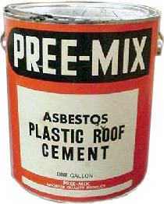
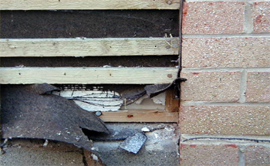
Asbestos in Buildings
Bitumen, Resins & Mastics
  Adhesives
  Caulking
  Sealants
  Roof coating
  Roofing felt
  Gutter lining
  DPC

Slide 43
